Slide 1
Text Analysis

Slide 2
Text analysis pipeline
Deep learning
Input
Morphology
Syntax
Semantics
Context
Text search
Text spellchecking
Sentiment analysis
Translation
Text
Speech analysis
OCR
AI assistants
Chat bots
Grammar checking
Grammarly.com
I have several cats (->cat)

Slide 3
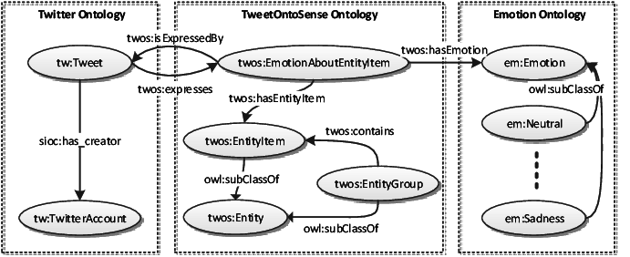
Ontology modeling

Slide 4
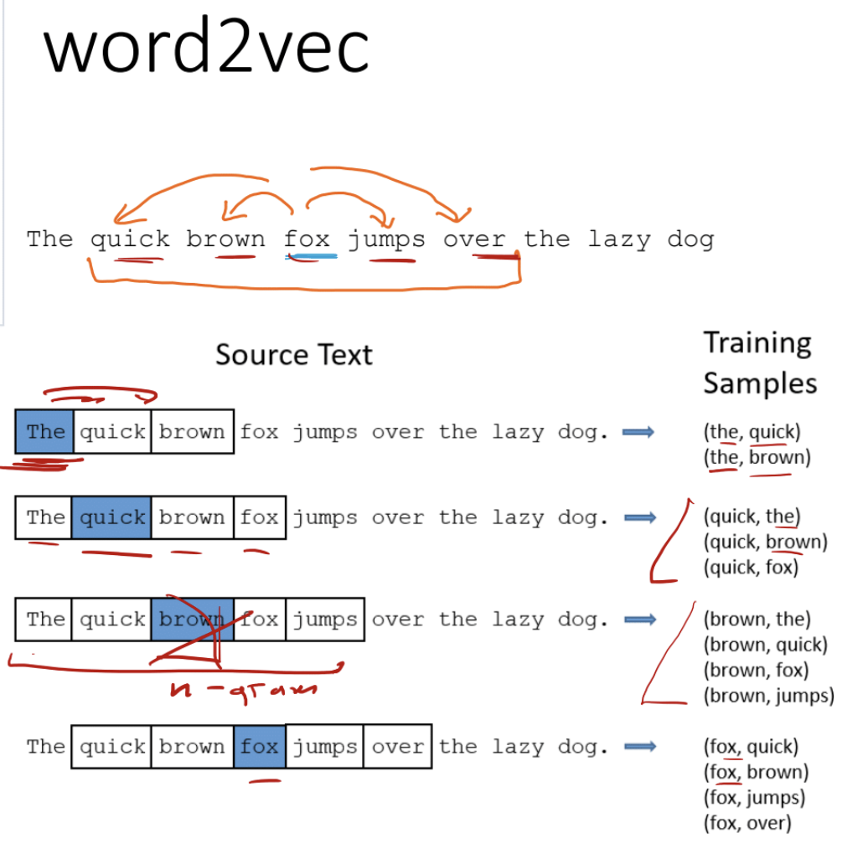
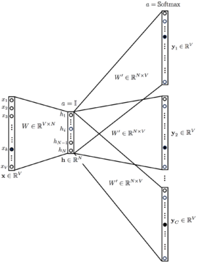
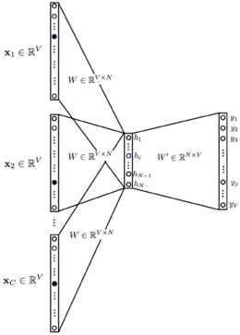


Skip-gram CBOW

Slide 5








Slide 6
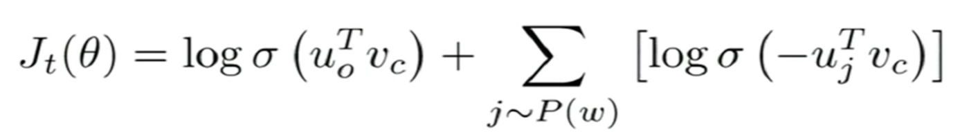
Negative sampling
Negative sampling allows us to only modify a small percentage of the weights, rather than all of them for each training sample.
Instead of trying to predict the probability of being a nearby word for all the words in the vocabulary, we try to predict the probability that our training sample words are neighbors or not.
The first term tries to maximize the probability of occurrence for actual words that lie in the context window, i.e. they co-occur. While the second term, tries to iterate over some random words j that don’t lie in the window and minimize their probability of co-occurrence.

Slide 7
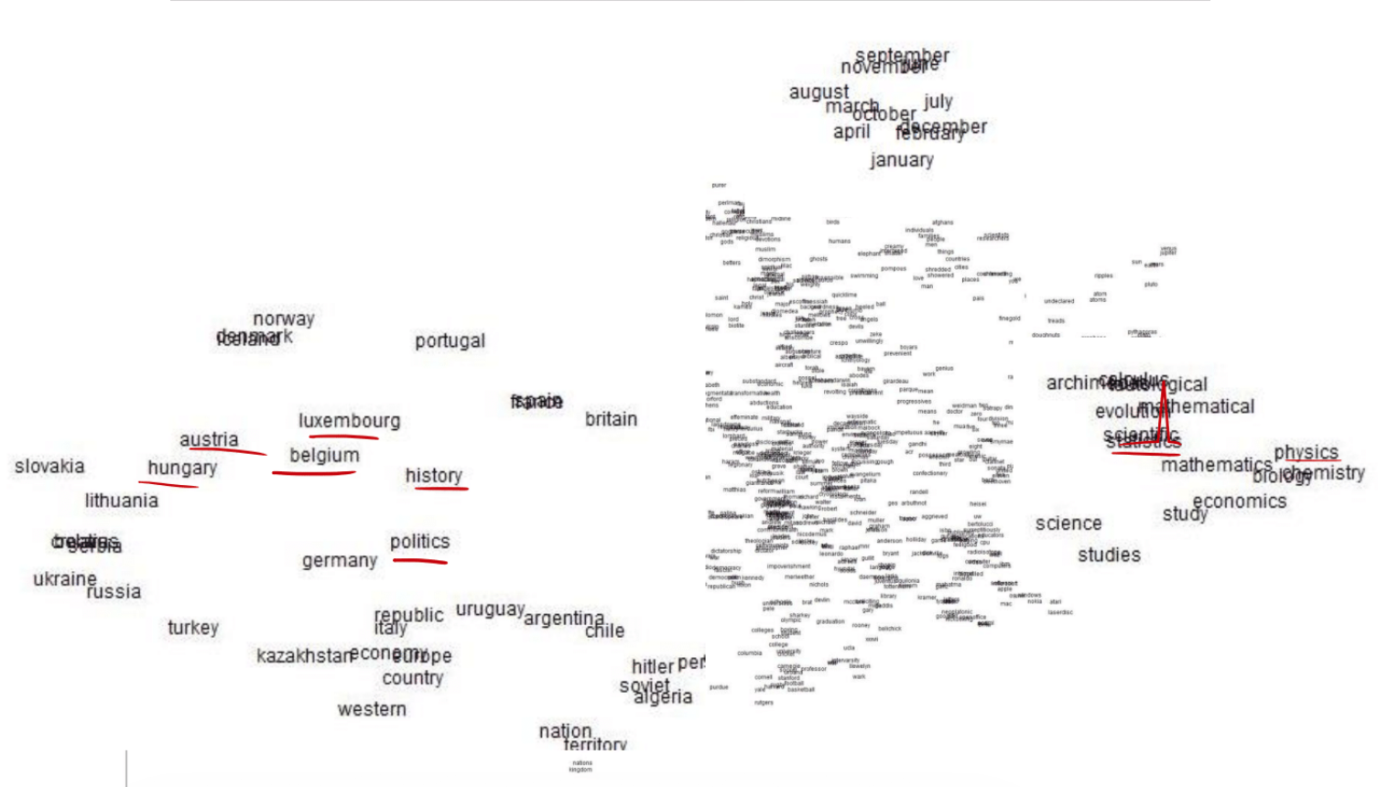





Word vector space

Slide 8




Slide 9
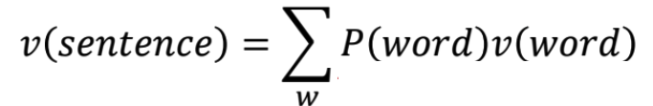
Sentiment analysis
The film is powerful, accessible and funny
The movie is well done, but slow
Ah yes, and there’s the music

Slide 10
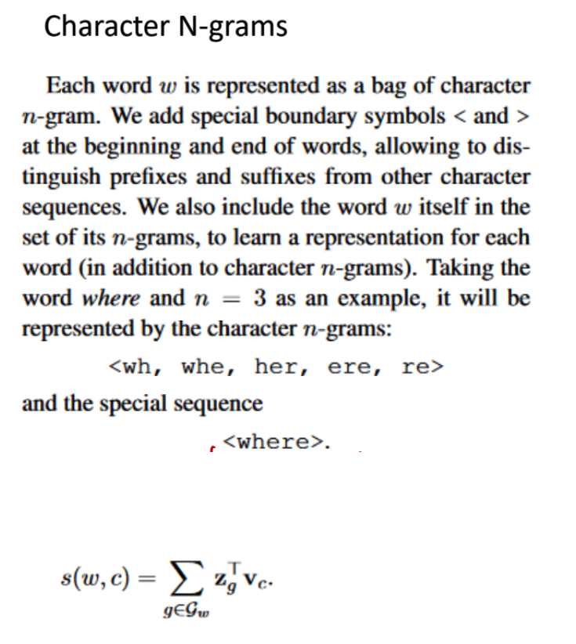
FastText from Facebook (Meta)
Out of vocabulary problem

Slide 11
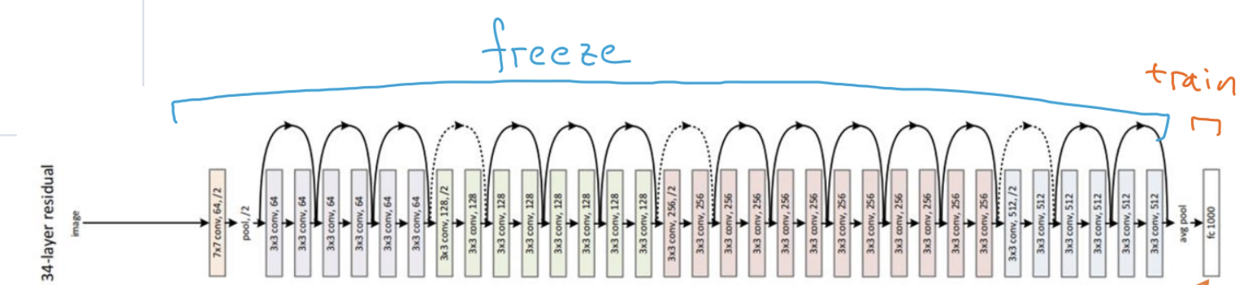


Pretrained vectors
https://nlp.stanford.edu/projects/glove/
https://code.google.com/archive/p/word2vec/
https://github.com/facebookresearch/fastText

Slide 12

RNN

Slide 13
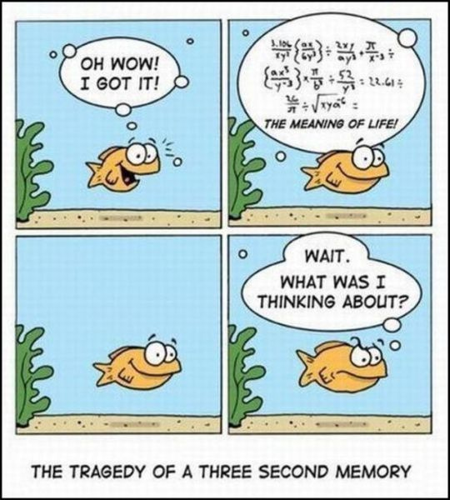
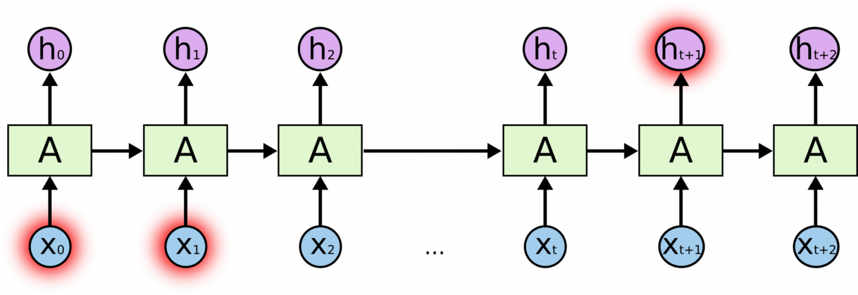
Memory problem

Slide 14
Try it
https://colab.research.google.com/github/fchollet/deep-learning-with-python-notebooks/blob/master/chapter11_part02_sequence-models.ipynb

Slide 15


LSTM
http://colah.github.io/posts/2015-08-Understanding-LSTMs/

Slide 16
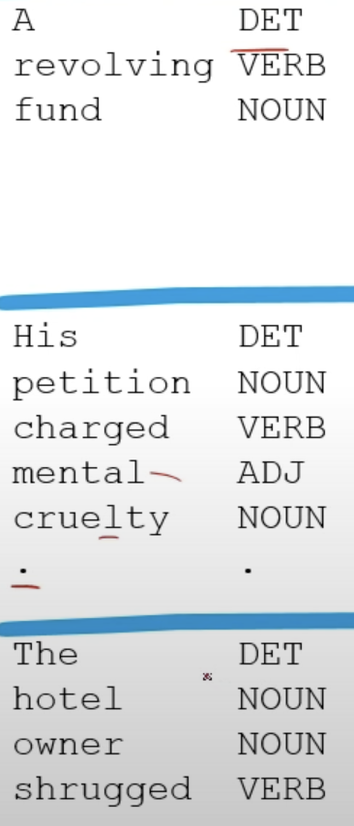
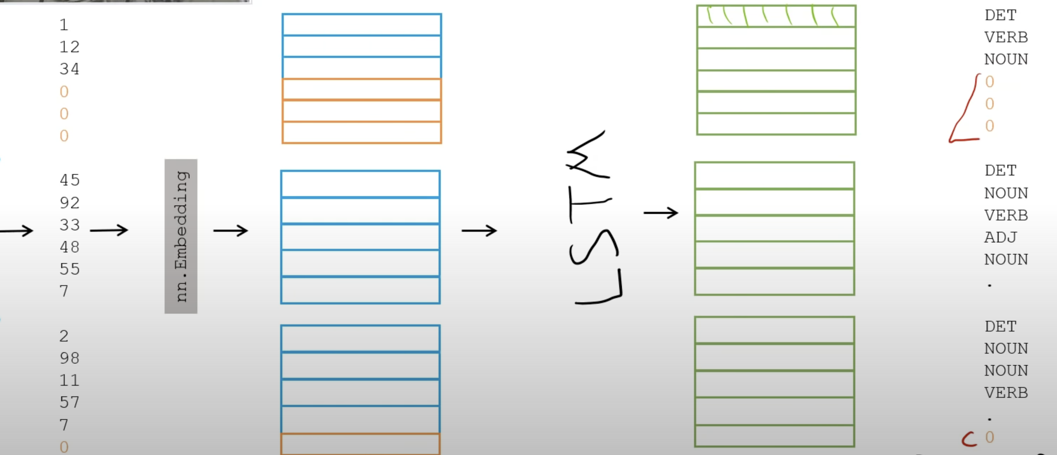
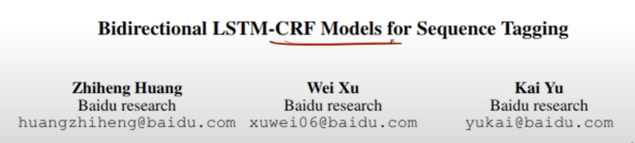
Part of speech tagging

Slide 17
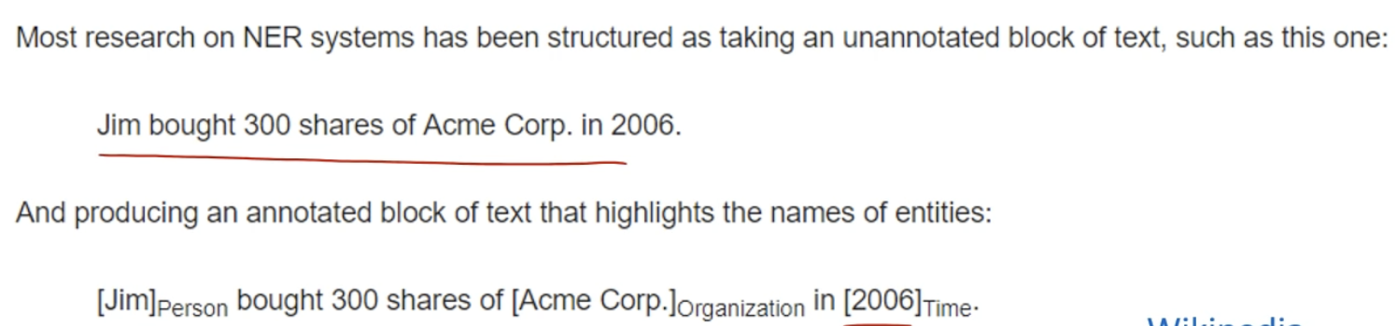

Named entity recognition

Slide 18
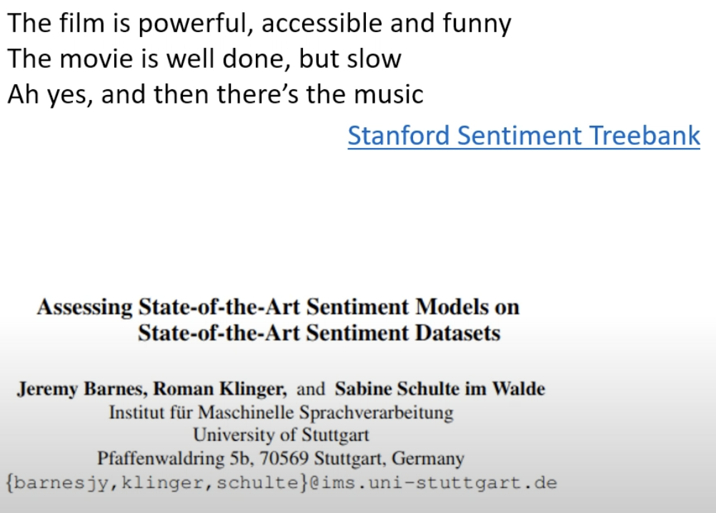
Sentiment analysis

Slide 19
